Slide 1
Analyzing Telecom Churn Data for Business Insights and Predictive Modeling
Problem Statement
Analyze the telecom churn dataset to uncover key business insights through exploratory data analysis (EDA), understand customer churn patterns, and develop a classification model to predict customer churn.
Prepared By: Maria Salma Burke
Batch: BADM MB_28

Slide 2
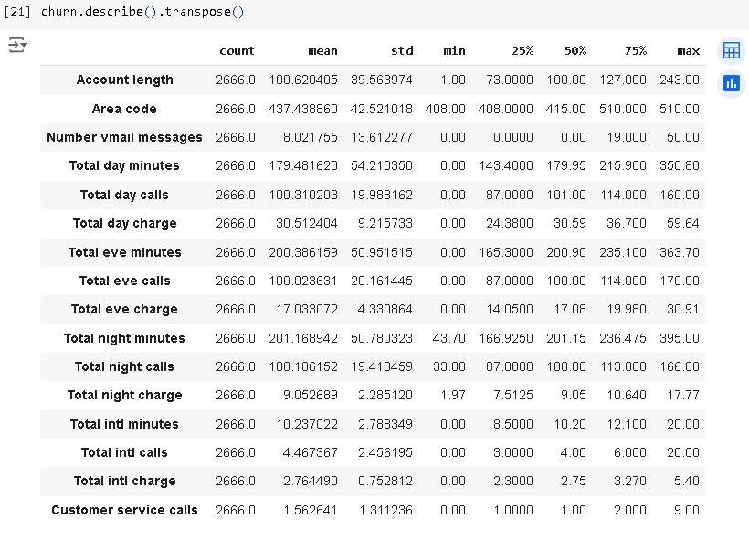
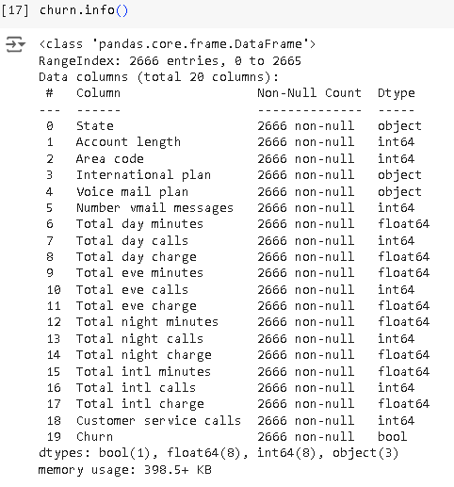

Exploratory Data Analysis (EDA):

Slide 3
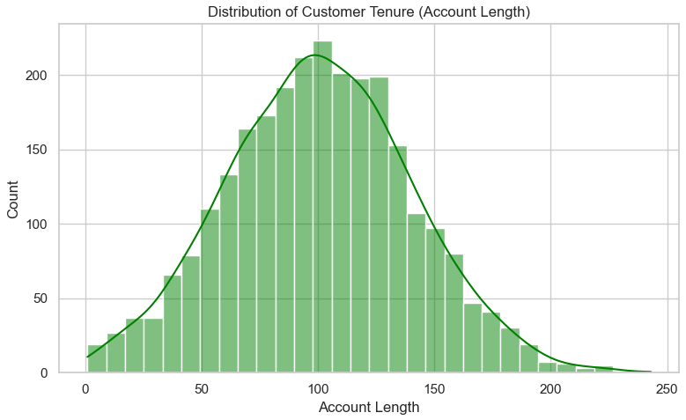
Exploratory Data Analysis (EDA):
Results:
Most customers stay for 90–120 days, making this the most common tenure range.
Very short-tenure (0–30 days) and long-tenure (180+ days) customers are fewer.
The chart shows a bell-shaped distribution, with most customers around the average tenure.
Suggestions:
Focus on retaining customers in the 90–120 days range with rewards or offers.
Improve onboarding to engage new customers in the 0–30 days range.
Reward long-tenure customers (180+ days) with loyalty benefits to retain them.
Syntax:
plt.figure(figsize=(8, 5))
sns.histplot(df["Account length"], bins=30, kde=True, color='green')
plt.title("Distribution of Customer Tenure (Account Length)")
plt.xlabel("Account Length")
plt.ylabel("Count")
plt.tight_layout()
plt.show()

Slide 4
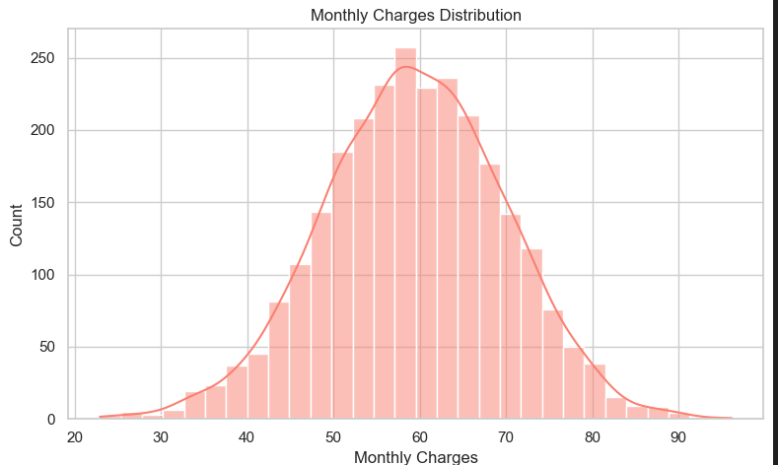
Exploratory Data Analysis (EDA):
Results :
Normal Distribution: The charges are normally distributed, with most customers paying around 30.
Frequency: The peak frequency occurs between 20 and 40, indicating a common billing range among subscribers.
Outliers: There are fewer instances of charges exceeding 50, highlighting that very high bills are less common.
Suggestions:
Consider reviewing pricing strategies to ensure competitiveness in the most common charge range.
Examine customers with higher charges to identify potential issues or areas for improvement in service plans.
Syntax:
df["Monthly Charges"] = df["Total day charge"] + df["Total eve charge"] + df["Total night charge"] + df["Total intl charge"]
plt.figure(figsize=(8, 5))
sns.histplot(df["Monthly Charges"], bins=30, kde=True, color='salmon')
plt.title("Monthly Charges Distribution")
plt.xlabel("Monthly Charges")
plt.ylabel("Count")
plt.tight_layout()
plt.show()

Slide 5
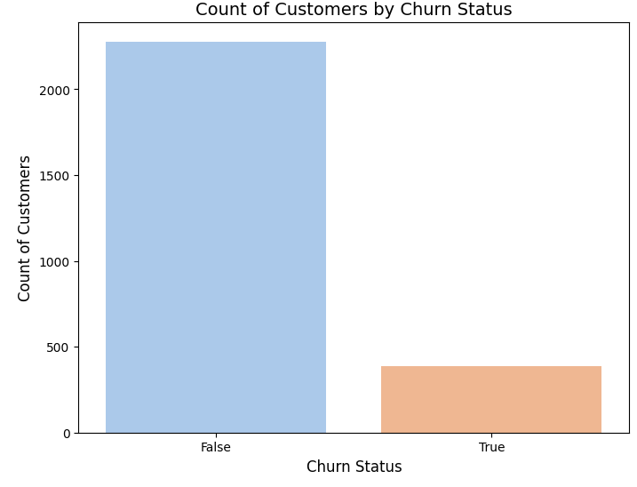
Exploratory Data Analysis (EDA):
Results:
Churn Status: A significant majority of customers (over 2,000) do not churn (False), indicating high retention.
Churn Rate: Only a small proportion (around 500) of customers have churned (True), suggesting low customer turnover.
Suggestions:
To further decrease churn, focus on customer engagement strategies, feedback mechanisms, and enhancing service quality to retain existing subscribers.
Conduct targeted retention campaigns for the small percentage of customers at risk of churning to understand their concerns and improve satisfaction.
Syntax:
plt.figure(figsize=(6, 4))
sns.countplot(data=df, x="Churn", palette="Set2")
plt.title("Count of Customers by Churn Status")
plt.xlabel("Churn")
plt.ylabel("Number of Customers")
plt.tight_layout()
plt.show()

Slide 6
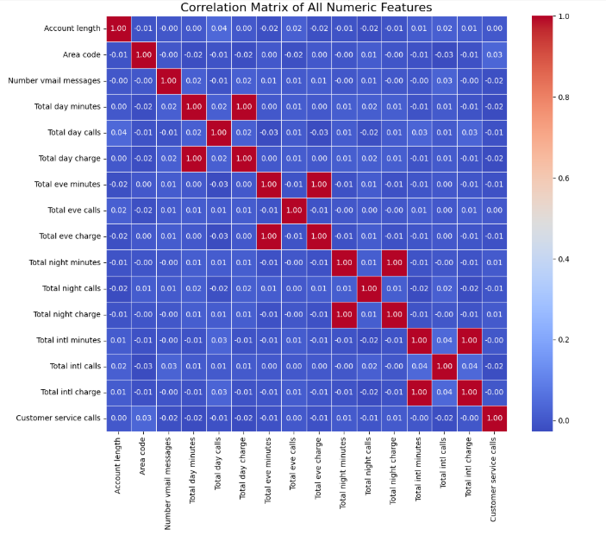
Correlation Analysis:
Results:
Strong Correlations:
Total Day Minutes and Total Day Charge is a strong positive correlation (0.93), indicating that more minutes used during the day leads to higher charges. Total Eve Minutes and Total Eve Charge also shows a strong correlation (0.89), suggesting similar behavior in evening usage.
Moderate Correlations:
Total Night Minutes and Total Night Charge (0.74) and Total Day Calls and Total Day Charge (0.67) indicate a positive relationship as well.
Weak/Slight Correlations: Features like "Number of vmail messages" show negligible correlation with charges, indicating other factors may influence those metrics.
Suggestions:
Leverage the strong correlations between usage minutes and charges to design tiered pricing plans encouraging higher usage.
Analyze customer behavior patterns to create targeted marketing campaigns for up-selling services based on call and charge metrics.
Syntax:
orrelation analysis between total minutes used and total charges
minutes_columns = [ "Total day minutes", "Total eve minutes", "Total night minutes", "Total intl minutes“]
charges_columns = ["Total day charge", "Total eve charge", "Total night charge", "Total intl charge“]
Create a correlation matrix for minutes and charges
correlation_df = df[minutes_columns + charges_columns].corr()
# Plot heatmap
plt.figure(figsize=(10, 8))
sns.heatmap(correlation_df, annot=True, cmap='coolwarm', fmt=".2f", square=True)
plt.title("Correlation between Minutes Used and Charges")
plt.tight_layout()
plt.show()

Slide 7
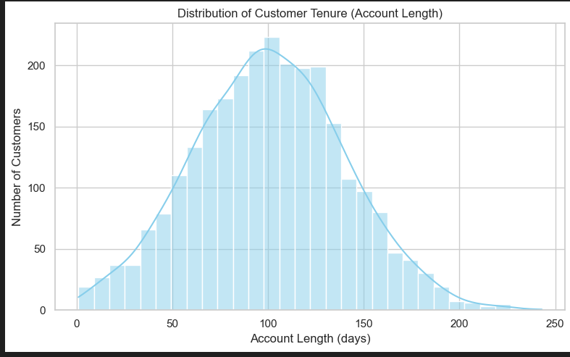
Distribution Analysis:
Account Length Distribution
Results:
Normal Distribution: Most customers have accounts around 100 months long.
Retention: Many customers stay with the service for 80 to 120 months, showing good retention.
Outliers: There are not many customers with accounts longer than 200 months.
Suggestions:
Engage with long-term customers to keep them happy and prevent them from leaving.
Offer special deals or rewards for customers who have been with the service for many months to encourage them to stay.
Syntax:
plt.figure(figsize=(8, 5))
sns.histplot(df["Account length"], bins=30, kde=True, color='skyblue')
plt.title("Distribution of Customer Tenure (Account Length)")
plt.xlabel("Account Length (days)")
plt.ylabel("Number of Customers")
plt.tight_layout()
plt.show()

Slide 8
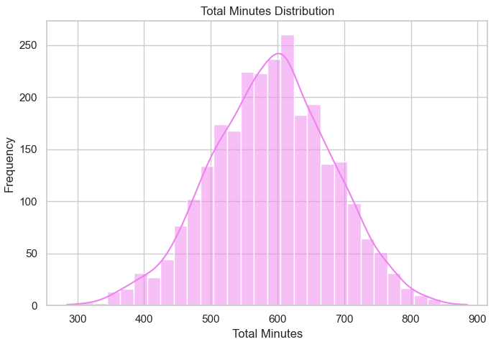
Distribution Analysis:
Total Minutes Distribution
Results:
Normal Distribution: The total minutes used by customers (day, evening, night, and international) follow a normal distribution, with most customers using around 600 minutes.
Peak Usage: The highest frequency of usage is between 500 and 700 minutes, indicating this is a common range among customers.
Few Extreme Users: There are fewer customers using significantly more or fewer than 300 to 900 minutes.
Suggestions:
Consider creating usage plans or promotions targeting the most common range of 500 to 700 minutes to encourage more usage.
Analyze high-usage customers to identify what might contribute to their increased activity, which can inform strategies for less active users.
Syntax:
df["Total Minutes"] = df["Total day minutes"] + df["Total eve minutes"] + df["Total night minutes"] + df["Total intl minutes"]
Total Minutes and Total Charges Distribution
fig, axes = plt.subplots(1, 2, figsize=(14, 5))
sns.histplot(df["Total Minutes"], bins=30, kde=True, ax=axes[0], color='violet')
axes[0].set_title("Total Minutes Distribution")
axes[0].set_xlabel("Total Minutes")
axes[0].set_ylabel("Frequency")

Slide 9
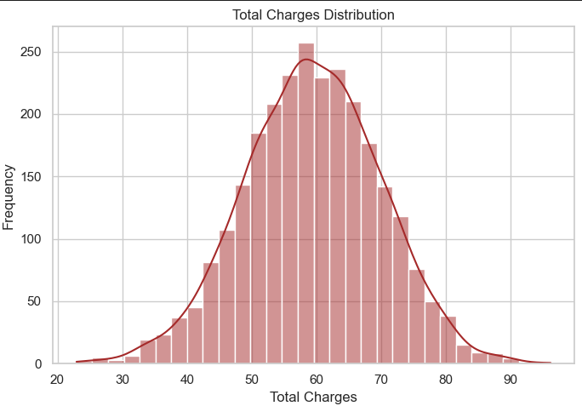
Distribution Analysis:
Findings:
Normal Distribution: The total charges (for day, evening, night, and international calls) are normally distributed, with most customers paying around 60.
Peak Charges: The highest frequency of charges is between 50 and 65, indicating this amount is common among customers.
Fewer High Charges: There are fewer customers with charges exceeding 80, showing that very high bills are less common.
Suggestions:
Consider offering flexible pricing plans or discounts for customers near the 60 charge mark to improve satisfaction and retention.
Investigate factors contributing to higher charges for some customers to better tailor service offerings and pricing strategies.
Syntax:
df["Total Charges"] = df["Total day charge"] + df["Total eve charge"] + df["Total night charge"] + df["Total intl charge"]
sns.histplot(df["Total Charges"], bins=30, kde=True, ax=axes[1], color='brown')
axes[1].set_title("Total Charges Distribution")
axes[1].set_xlabel("Total Charges")
axes[1].set_ylabel("Frequency")
plt.tight_layout()
plt.show()
Total Charges Distribution

Slide 10
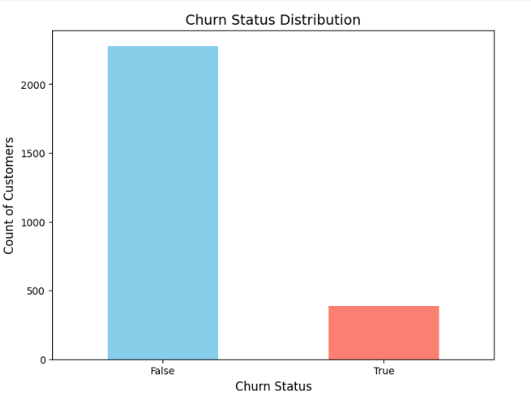
Distribution Analysis:
CHURN STATUS Distribution
Findings:
A significant majority of customers (over 2,000) do not churn (False), indicating high retention.
Only a small proportion (around 500) of customers have churned (True), suggesting low customer turnover.
Suggestions:
To further decrease churn, focus on customer engagement strategies, feedback mechanisms, and enhancing service quality to retain existing subscribers.
Syntax:
plt.figure(figsize=(6, 4))
sns.countplot(data=df, x="Churn", palette="pastel")
plt.title("Churn Status Distribution")
plt.xlabel("Churn")
plt.ylabel("Number of Customers")
plt.tight_layout()
plt.show()

Slide 11

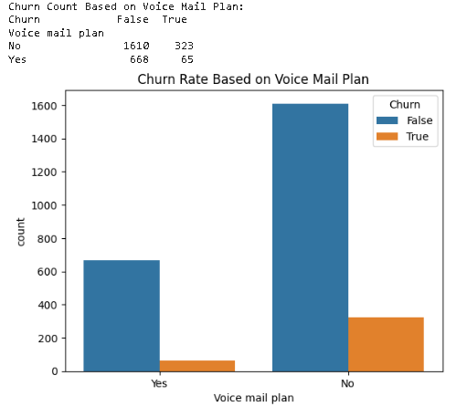
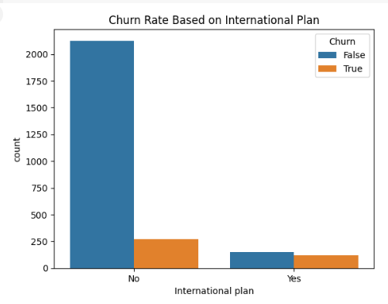
Business Insights
Churn Rate by International and Voice Mail Plan
The majority of customers don’t have international Plan so the Churn rate is minimal based on international Plan.
Less number of customers only churn with Voice mail plan but No Voice mail customers are churning more compared with Voice mail customers.

Slide 12
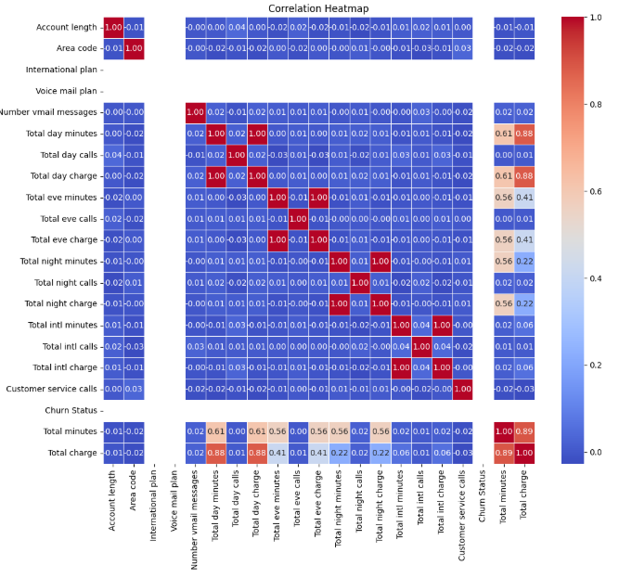
Classification Modeling:
Feature Selection:

Slide 13
Classification Modeling:
Feature Selection:
This shows correlations between various features and churn status. Here's a breakdown:
Correlation Scale: Values range from -1 (perfect negative correlation) to 1 (perfect positive correlation).
2. Key Findings:
Account Length: Shows a moderate negative correlation with churn. Longer account lengths are associated with lower churn rates.
Total Day Minutes and Other Call Metrics: Likely have correlations that can be noted, although their exact values aren't detailed in description.
Overall, this heatmap suggests several areas for investigation, particularly around customer service interactions and their potential link to churn. Identifying factors contributing to churn could help improve retention strategies.

Slide 14
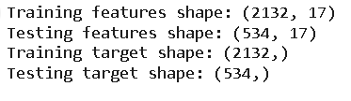
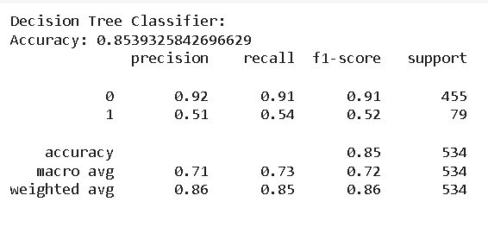
Classification Modeling:
Decision Tree Classifier
Accuracy: 0.85
The model correctly predicted 85% of the churn predictions. This is a good indicator that the model has a reasonably high success rate overall.
Class 0 (Non-Churn)
Precision: 0.92
Precision is the proportion of correctly predicted non-churn customers (true positives) out of all instances the model predicted as non-churn. The model predicted non-churn customers correctly 92% of the time.
F1-Score: 0.91
The model has a very high F1-score for non-churn customers, meaning it's doing well at both correctly predicting non-churn customers and not misclassifying them as churn.
Recall: 0.91
Recall is the proportion of actual non-churn customers (true positives) that were correctly predicted by the model. It indicates how well the model identifies all the non-churn customers.

Slide 15
Classification Modeling:
Decision Tree Classifier
Accuracy: 0.85
The model correctly predicted 85% of the churn predictions. This is a good indicator that the model has a reasonably high success rate overall.
Class 1 (Churn)
Precision: 0.54
Precision for churn customers (class 1) is much lower. It means that only 51% of the customers predicted as "churn" were actually churn customers.
F1-Score: 0.52
This score is much lower than for non-churn customers, which indicates that the model has room for improvement in predicting churn cases.
Recall: 0.54
The model is identifying just over half of the actual churn cases, but misses a significant portion (false negatives).

Slide 16
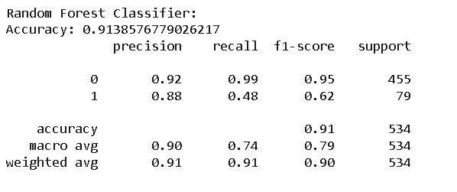
Classification Modeling:
Random Forest Classifier
Accuracy: 0.91
Random Forest Classifier correctly predicted 91% of the total data points, which is a high performance overall.
The model is doing a great job at correctly predicting whether a customer will churn or not, on average.
Class 0 (Non-Churn)
Precision: 0.92
Precision for this non-churn means that 92% of the customers predicted to not churn were actually non-churn customers.
F1-Score: 0.95
F1-score is the harmonic mean of precision and recall, providing a balance between the two. With an F1-score of 0.95 for class 0, it reflects the high performance of the model in predicting non-churn customers.
Recall: 0.99
Recall for class 0 indicates that 99% of actual non-churn customers were correctly identified by the model.
The model has a very high recall for non-churn customers, meaning it misses very few of them

Slide 17
Classification Modeling:
Random Forest Classifier
Accuracy: 0.91
Random Forest Classifier correctly predicted 91% of the total data points, which is a high performance overall.
The model is doing a great job at correctly predicting whether a customer will churn or not, on average.
Class 1 (Churn)
Precision: 0.88
Precision for this non-churn means that 92% of the customers predicted to not churn were actually non-churn customers.
F1-Score: 0.62
The F1-score of 0.62 for churn customers suggests the model is moderately balanced in terms of precision and recall for the minority class (churn).
Recall: 0.48
Recall for class 1 indicates that only 48% of actual churn customers were correctly identified by the model.

Slide 18
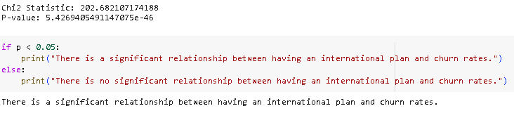
Additional Questions for Analysis:
Impact of International Plan on Churn
Chi-Square Test: You can conclude that the presence of an international plan has a significant impact on churn rates.

Slide 19
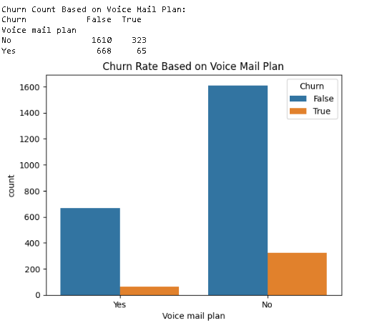
Additional Questions for Analysis:
Impact of VOICE MAIL Plan on Churn
Chi-Square Test: Similar to the previous analysis, you can conclude that the presence of a voice mail plan significantly influences churn rates.

Slide 20
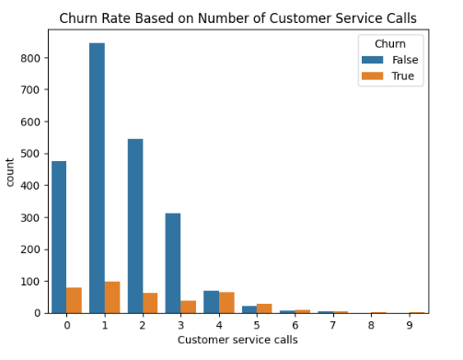
Additional Questions for Analysis:
CUSTOMER SERVICE CALL on Churn
There is a clear relationship between the number of customer service calls and churn, with churning customers typically making more calls.

Slide 21
Retention Strategies
Focus on customers with a high number of customer service calls, as they are more likely to churn. Implement proactive outreach to address their concerns before they decide to leave.
Enhance Customer Experience:
Improve customer service response times and solutions to reduce the necessity for frequent calls, especially for high-risk customers.
Analyze Heavy Users:
Monitor the patterns of heavy users (high total day minutes) for potential signs of dissatisfaction. Personalized offers or loyalty incentives could help retain these customers.
Review Plan Offerings:
Evaluate the impact of international and voice mail plans on churn rates. Promote these services to customers who do not currently have them, as they appear to correlate with lower churn.
State-Specific Strategies:
Develop tailored marketing and retention strategies based on churn trends in specific states identified as high-risk.

Slide 22
Conclusion
By The analysis reveals significant factors influencing customer churn, particularly the number of customer service calls and total day minutes used. Churning customers generally exhibit higher call volumes and usage patterns that warrant further investigation. By implementing targeted retention strategies, enhancing customer experience, and focusing on heavy users, the organization can effectively reduce churn rates and improve overall customer satisfaction. Further analysis may be necessary to refine these strategies and better understand state-specific dynamics.

Slide 23
Thank you

